Slide 1
EXPLORE SMART & SUSTAINABLE SOLUTIONS FROM SWEDEN

Slide 2
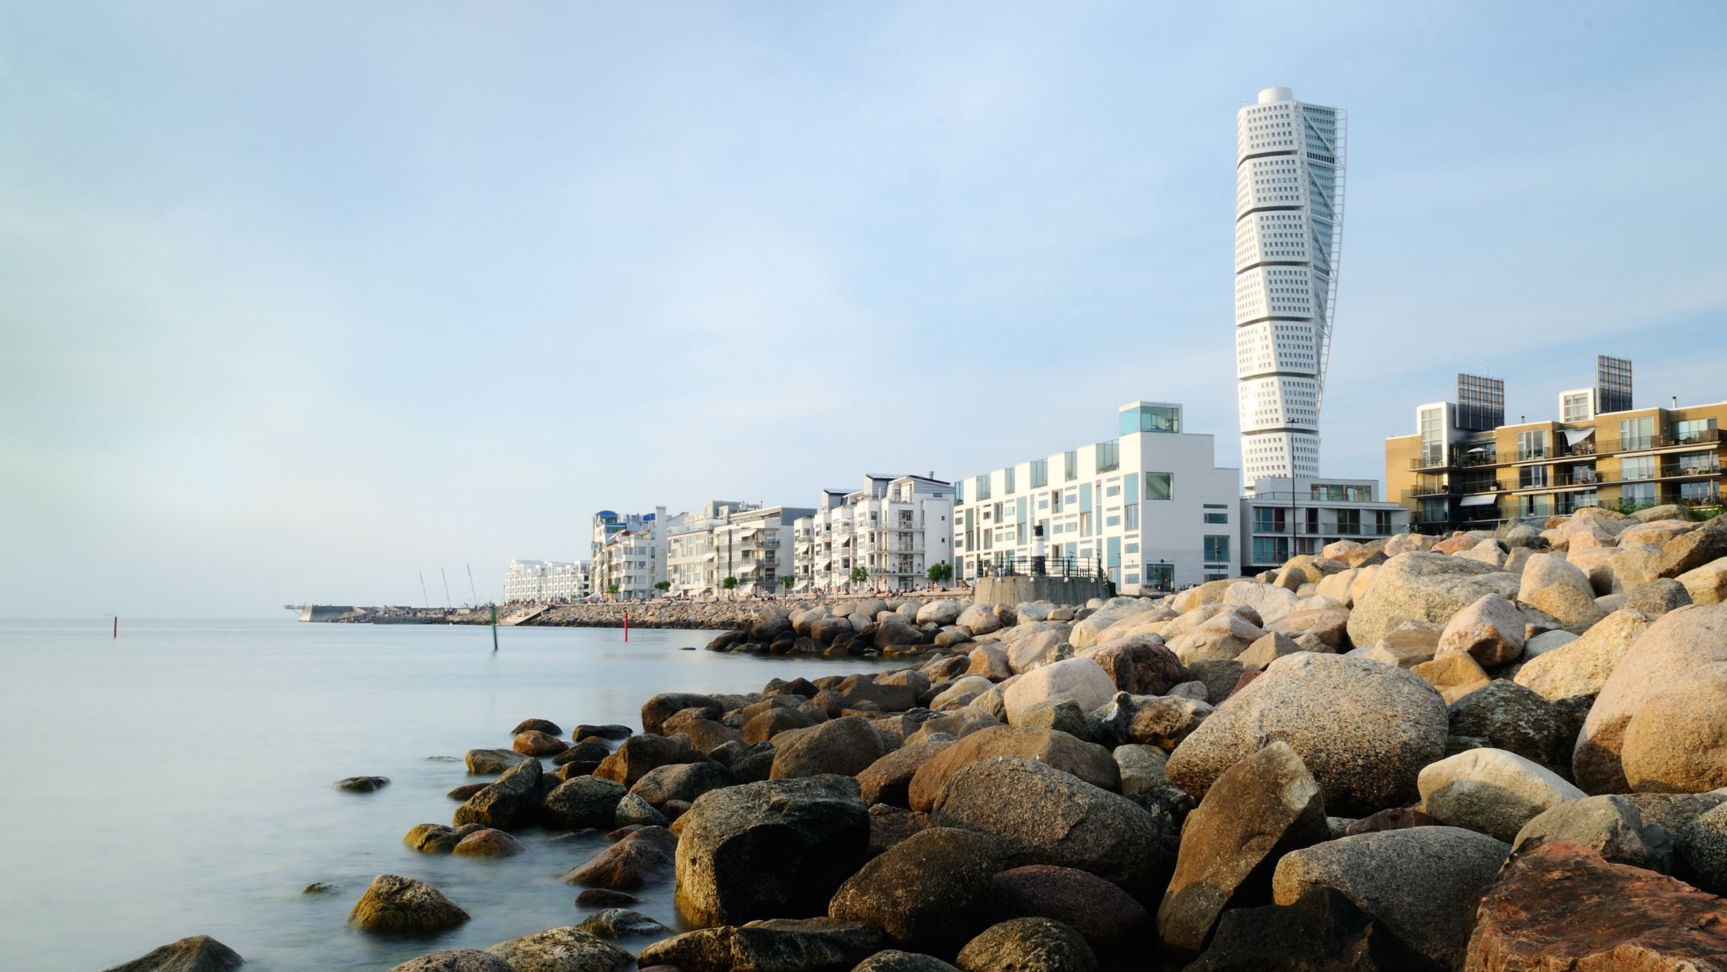
Sweden has high ambitions
National environmental quality objectives
Climate-political framework
Net zero emissions by 2045
70 % reduction of emissions from domestic transports by 2030

Slide 3
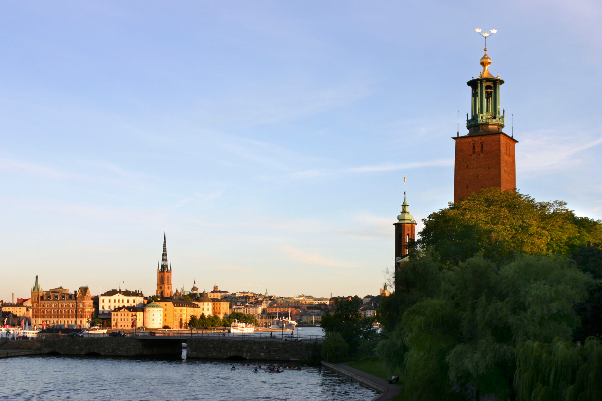
The first fossil-free welfare nation?
GDP + 85 %
Co2 emissions -27 %
Notes:
Since 1990, the Swedish CO2 emissions has decreased by 27 % (2018). A big part of that is the reduction from the elctrical and heating sectors, that are now almost fossil-free.
The reduction of co2 emissions is still going slow to reach the goals set up, but the reduction has not led to a reduction in GDP. On the contrary, Sweden has increased GDP by 85 % at the same time as CO2 emissions have gone down.

Slide 4
SUSTAINABLE DEVELOPMENT REPORT 2021​
SDG Global rank: 2 (of 165)​
Index score: 85.6
Notes:
In the latest Sustainable Development Report, Sweden was ranked nr 2 in reaching the Global Goals out of 165 countries. Sweden ranked high in goals such as gender equality (5), affordable and clean energy (7) and Sustainable cities and communities, but still face challenges reaching goals such as Sustainable consumption (12) and life below water (14).

Slide 5
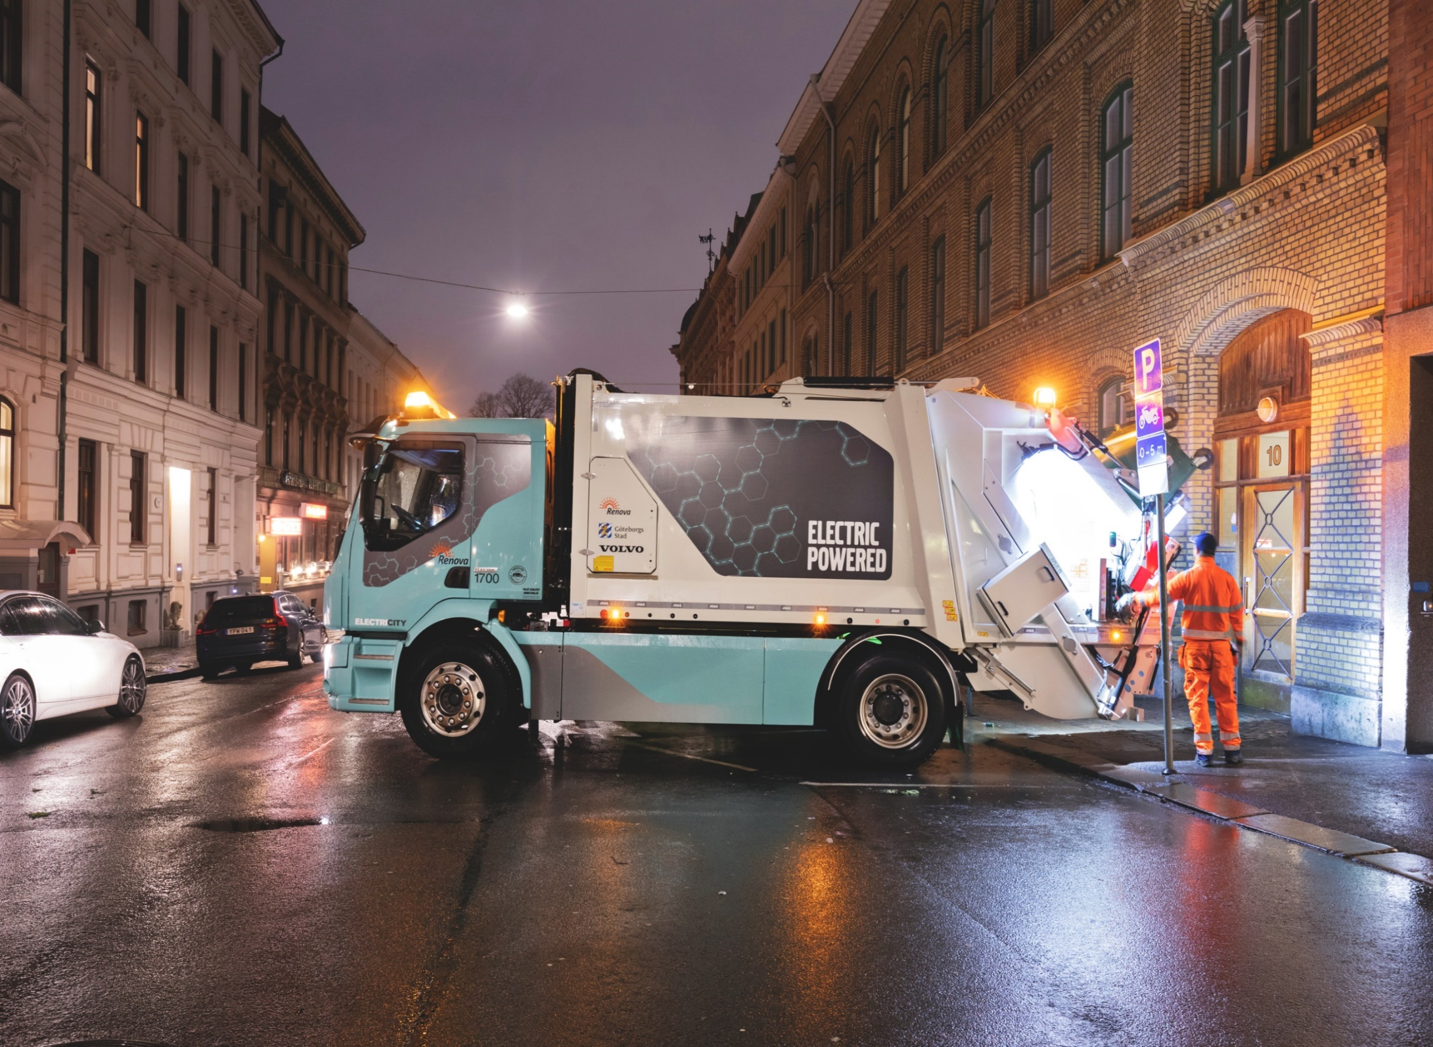
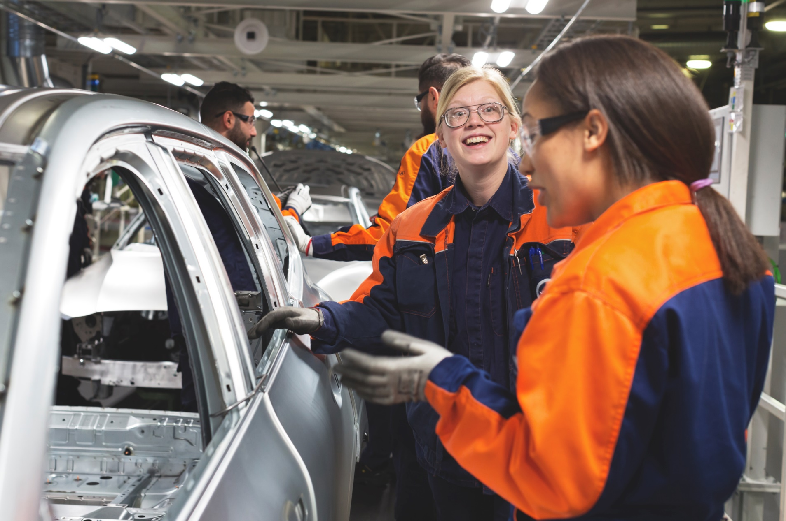
Sweden has come far in many areas…
Less than 1 % of the generated waste goes to landfill
Innovative mobility sector
99 % fossil-free electricity production
Nr 1 in the EU on the Gender Equality Index

Slide 6
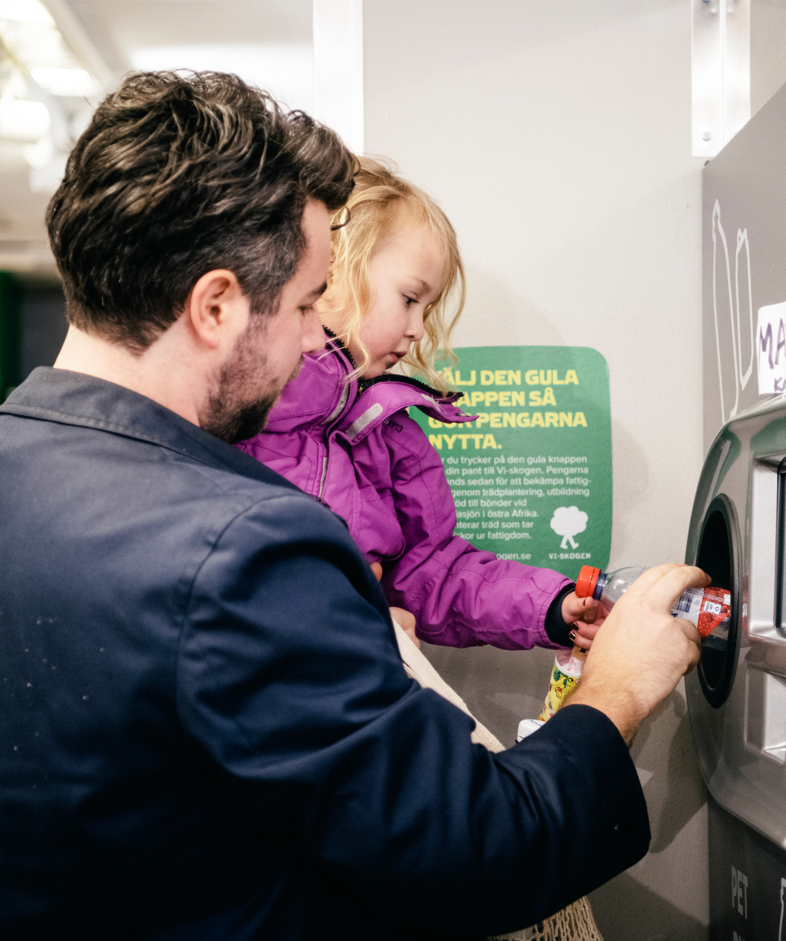
…but how did we get here?
Innovations
Citizen engagement​
System solutions ​
Eco Governance
Notes:
Sweden is well-known for our many innovations – both products and business ideas ​
We have a long history of educating our citizens and involving citizens in the process – one example is waste management, where citizens play a big part in sorting and collecting the waste
​
Eco Governance – common holistic goal for city planning . Sweden has for a long time worked with finding ways to cooperate between the private and the public sector, which has allowed us to establish long-lasting and sustainable system solutions for our cities, with win-win situations for both the tax payers and the companies involved ​

Slide 7
Smart City Sweden
The platform for cooperation in sustainable city solutions
Notes:
Smart City Sweden is a state-funded initiative for smart and sustainable city solutions from Sweden. Digitally and at our six offices around Sweden, we welcome delegations who are interested in learning and investing in Swedish solutions and implement them in their local context.

Slide 8
Focus areas
Energy, Climate & Environment
Mobility
Digitalisation
Urban Planning
Social Sustainability
Notes:
Smart City Sweden demonstrates solutions within 5 focus areas: Energy, climate & environment, mobility, digitalisation, urban planning and social sustainability from all around Sweden.

Slide 9
We work within all global goals

Slide 10
+700 companies​
+120 best practices from all over Sweden​
6 offices​
Notes:
Smart City Sweden has over 700 companies in our network, ready to take their solutions to international markets.
Over 120 best practices work as inspiration and can be visited.
6 offices all over Sweden welcome delegations, physically as well as digitally.

Slide 11
The Swedish Energy Agency
Head Office
Project
management
Communication
Visit Coordination
Business Development
Business Development
Council
Regional offices
Business Development
Group
North
Central
East
West
South- East
South
Notes:
Smart City Sweden consists of a wide range of actors that provide their expertise and regional knowledge in different fields. The project is coordinated by the Swedish Energy Agency and is managed by IVL Swedish Environmental Research Institute.
The head office and regional officies welcome delegations from all over the world that are interested in learning more about Swedish solutions and implementing them in their local context.

Slide 12
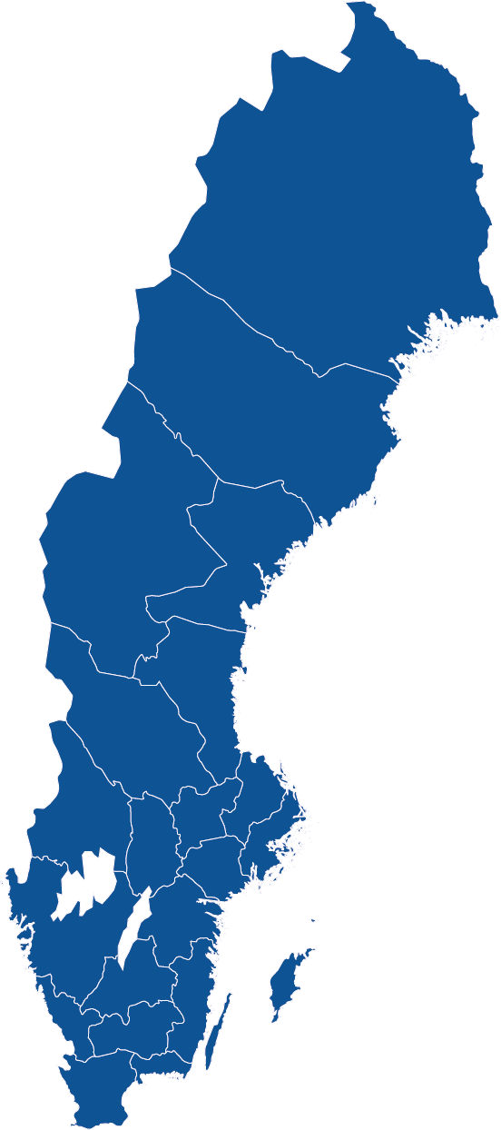
Smart City Sweden’s regional offices
Umeå
Represented at 6 places in Sweden
All offices welcomes physical and digital meetings
Borlänge
Stockholm
Göteborg
Linköping
Malmö
Notes:
… and you can see the locations of the offices on this picture.

Slide 13
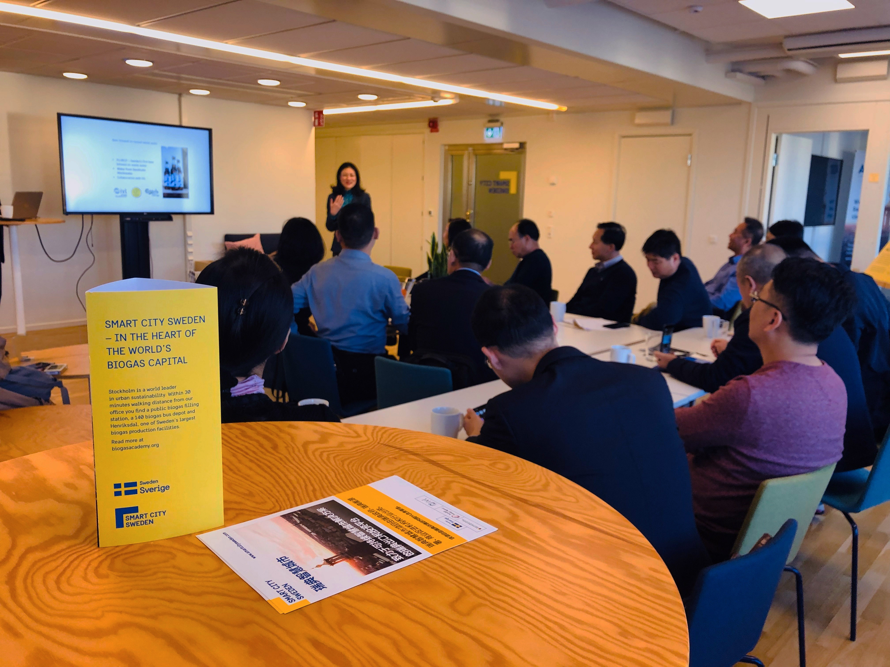
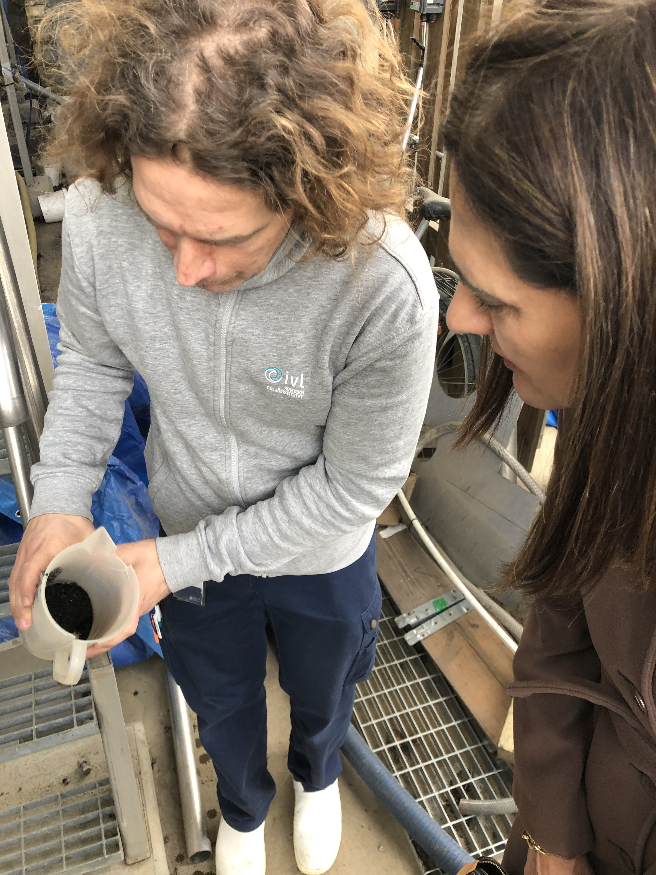
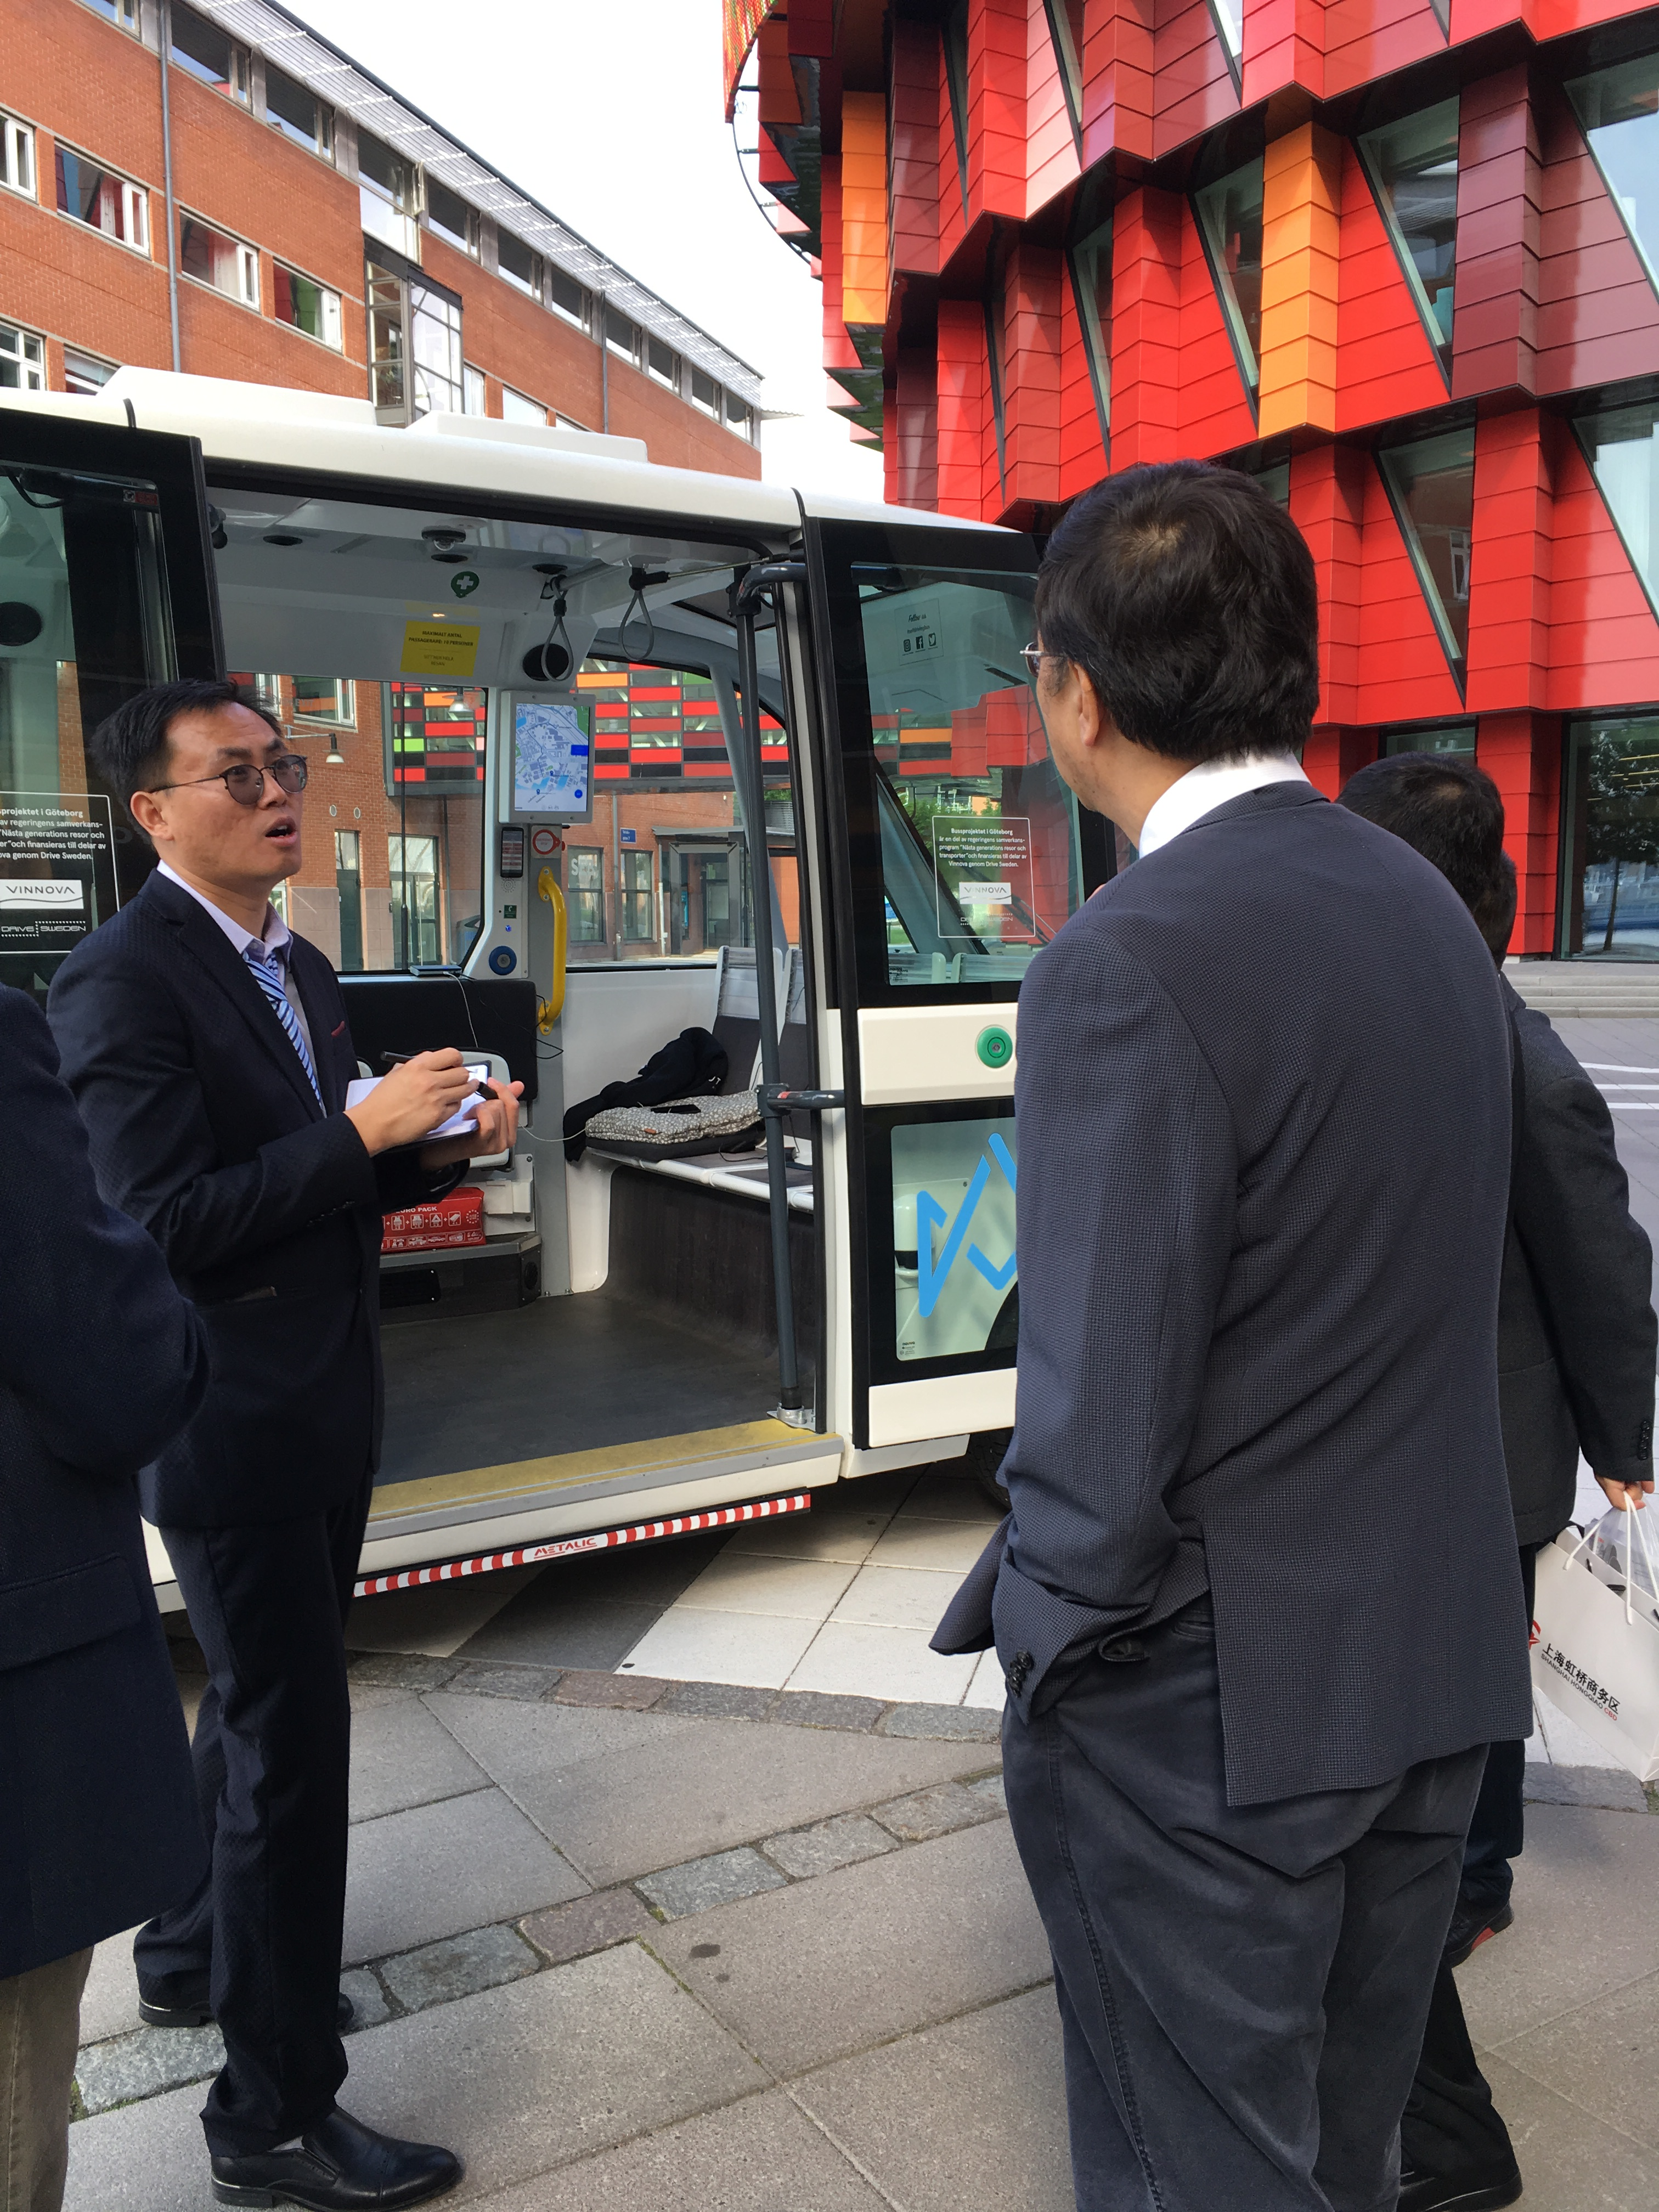
Our offer
Visits to any of our offices
Study visits to one or several of our over 120 study visit objects
Online visits
Webinars och livestreams
Match-making
Follow-up visits

Slide 14
The process
Business opportunity/
implementation
Process
Meeting request
Screening
Study visit
Notes:
Smart City Sweden is with you all the way. We can help to match you with experts and companies in your area of interest. After the visit, we will help you on to the next step, wether it is a new meeting to learn more about your needs or a pre-study in your local context.

Slide 15
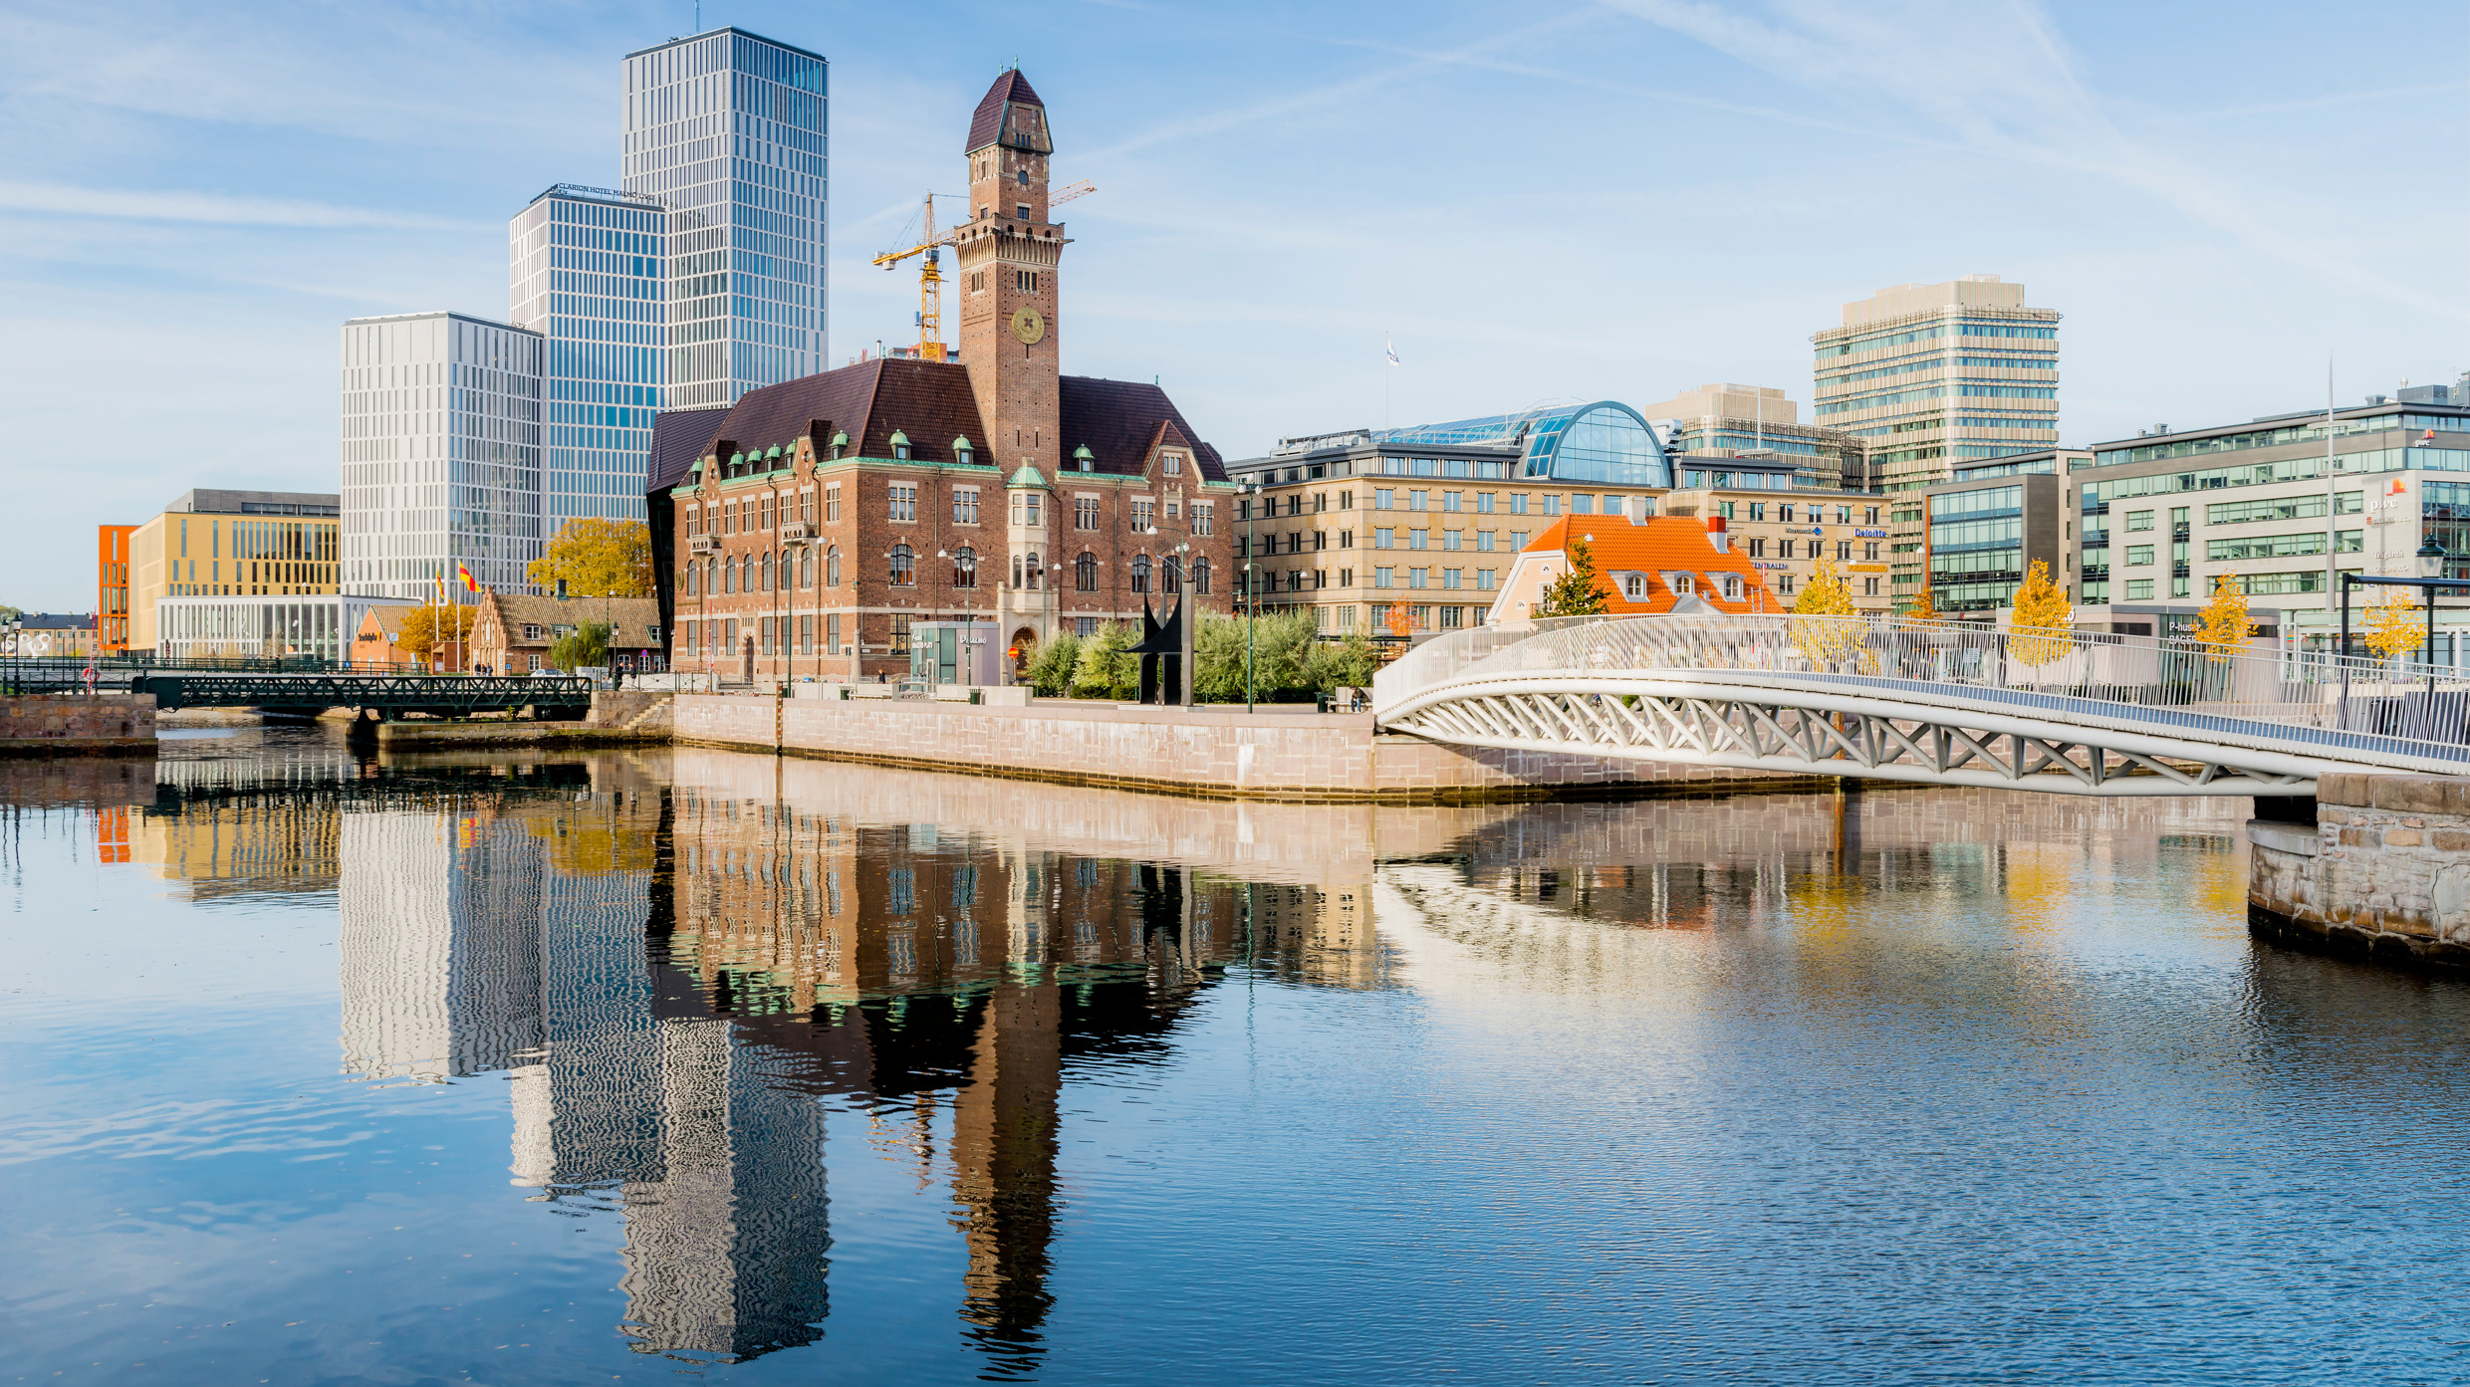
Results so far

Slide 16
Visitors 2021
2,648 visitors
168 delegations
69 countries

Slide 17
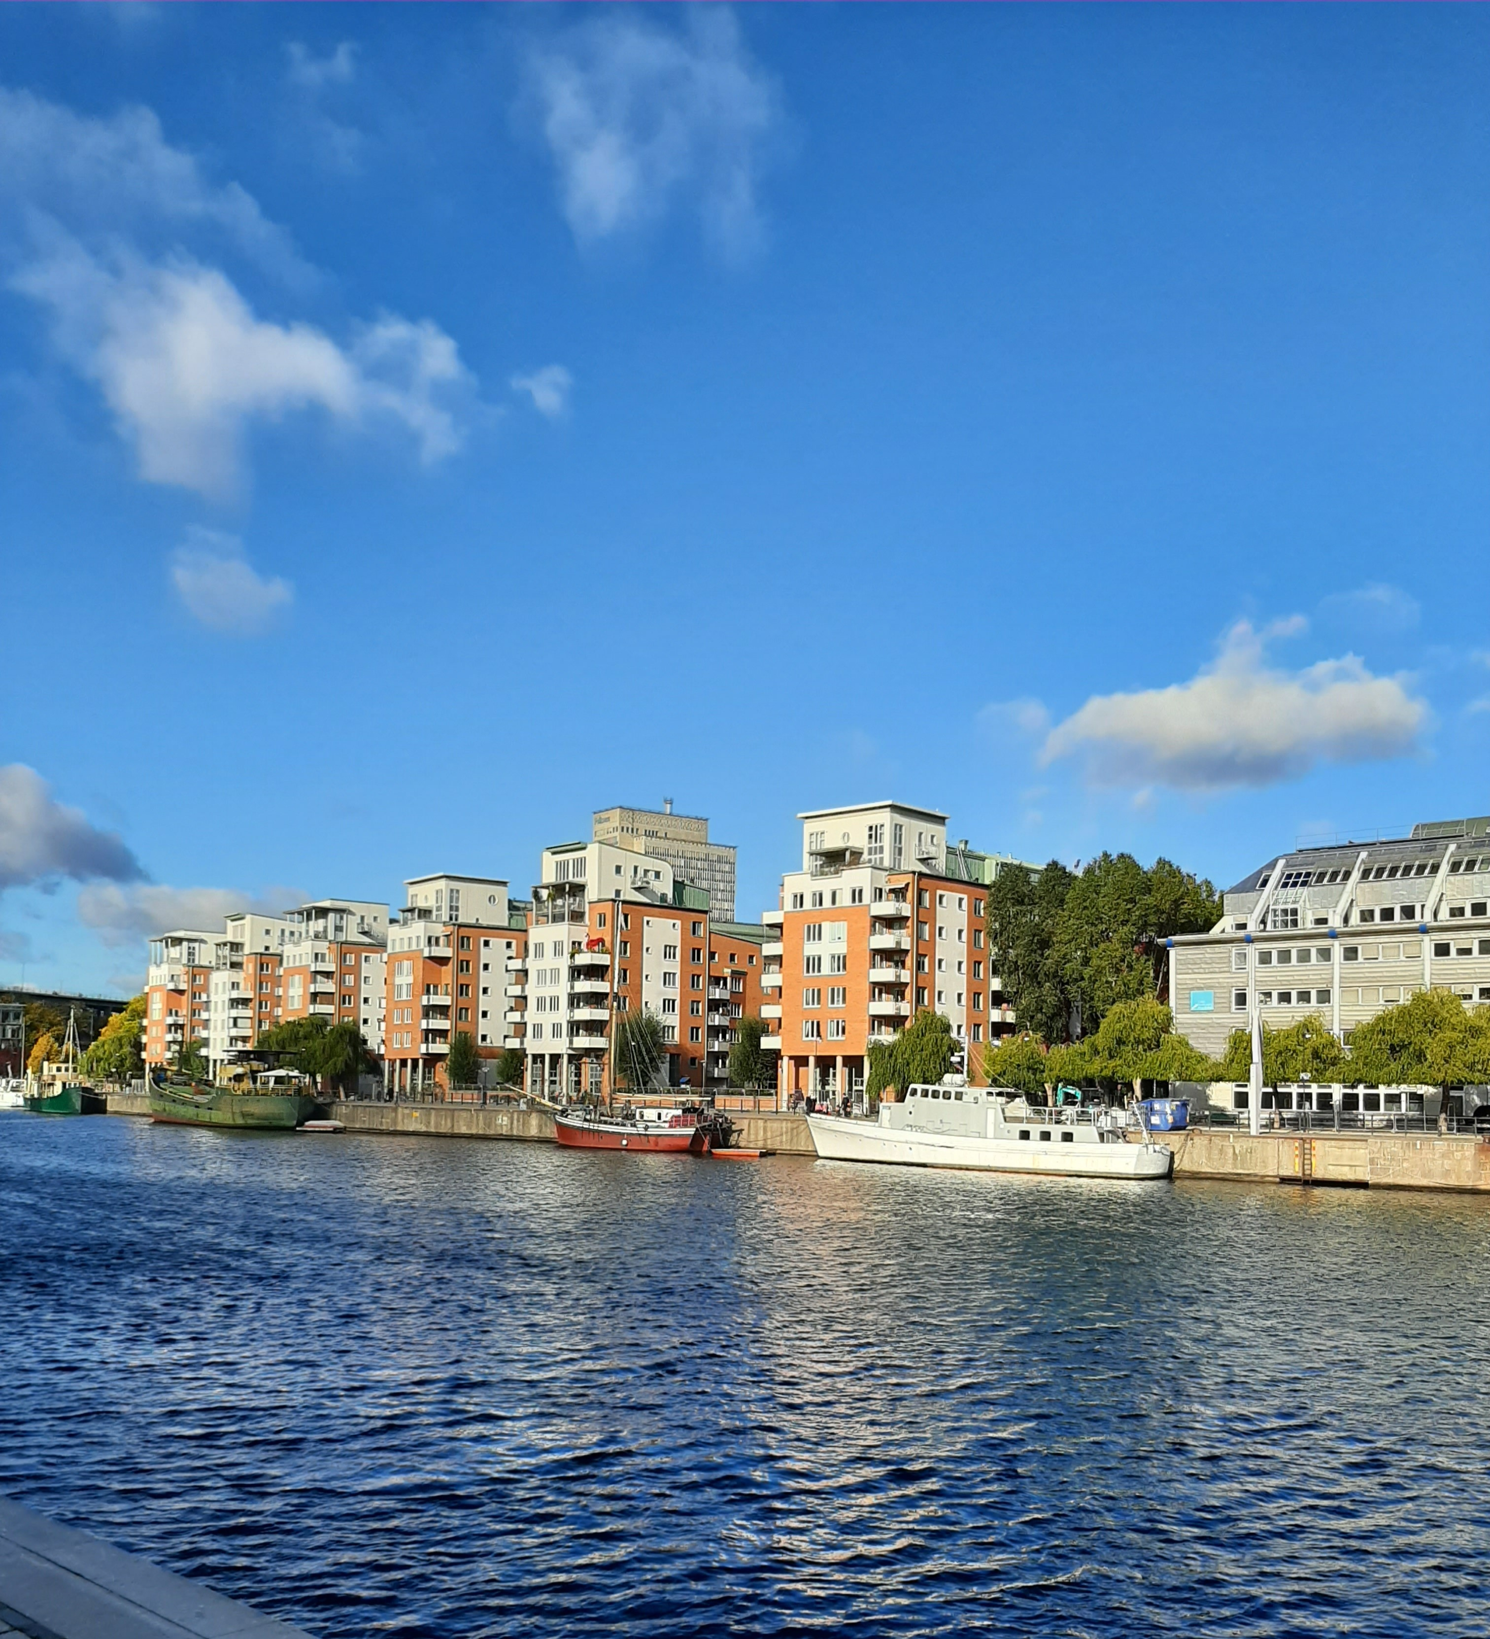
Results from visits
- Examples of finished or ongoing
pre-feasibility studies
Waste management in El Salvador
Smart grids in Ethiopia
Transport solutions in Morocco
Sustainable lighting in Somaliland
Urban planning in China

Slide 18
@SmartCitySweden
Smartcitysweden.com

